Slide 1
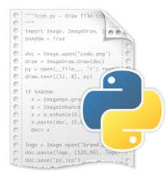
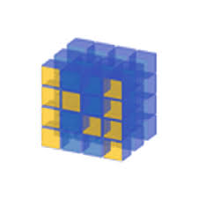
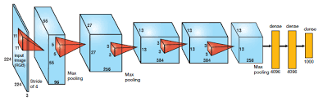
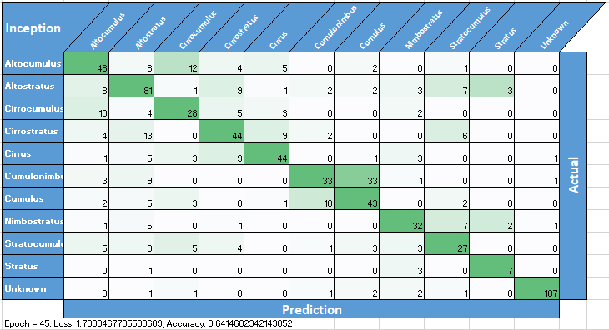
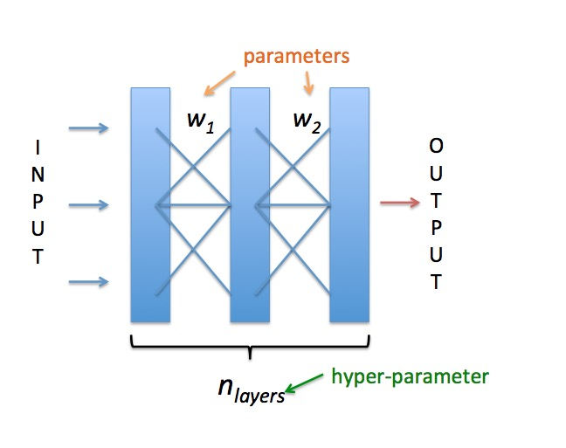
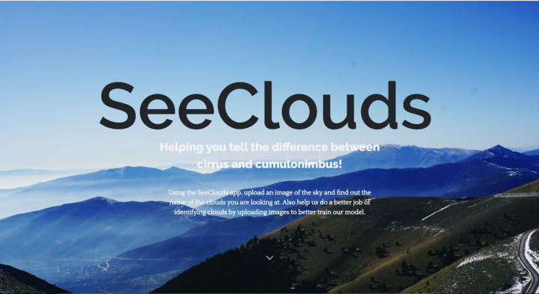
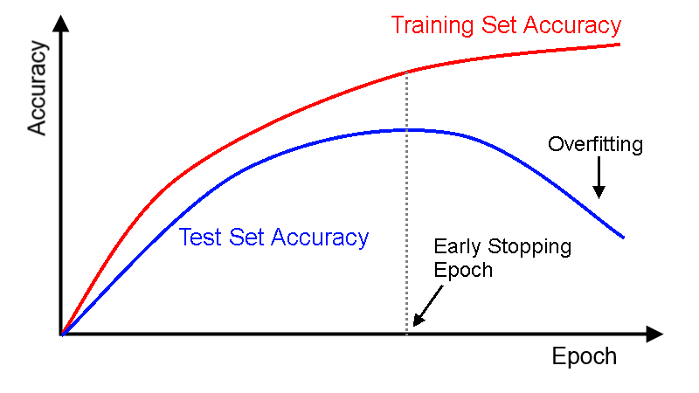
10
Clouds
Image
Curating
Search Bing API Script
Image Dataset
CNN
Models
X: (224,224,3)
y: (cumulus)
Training Models: AlexNet, Inception
Image Processing Script
NumPy array
Image
Curating
Adjust
Hyper-parameters
Re-train models on curated dataset
Confusion Matrix
Publish
Product
Model
Refinement
Create SeeClouds website
Implement Early Stopping
Training models with new hyperparameters

